Slide 1
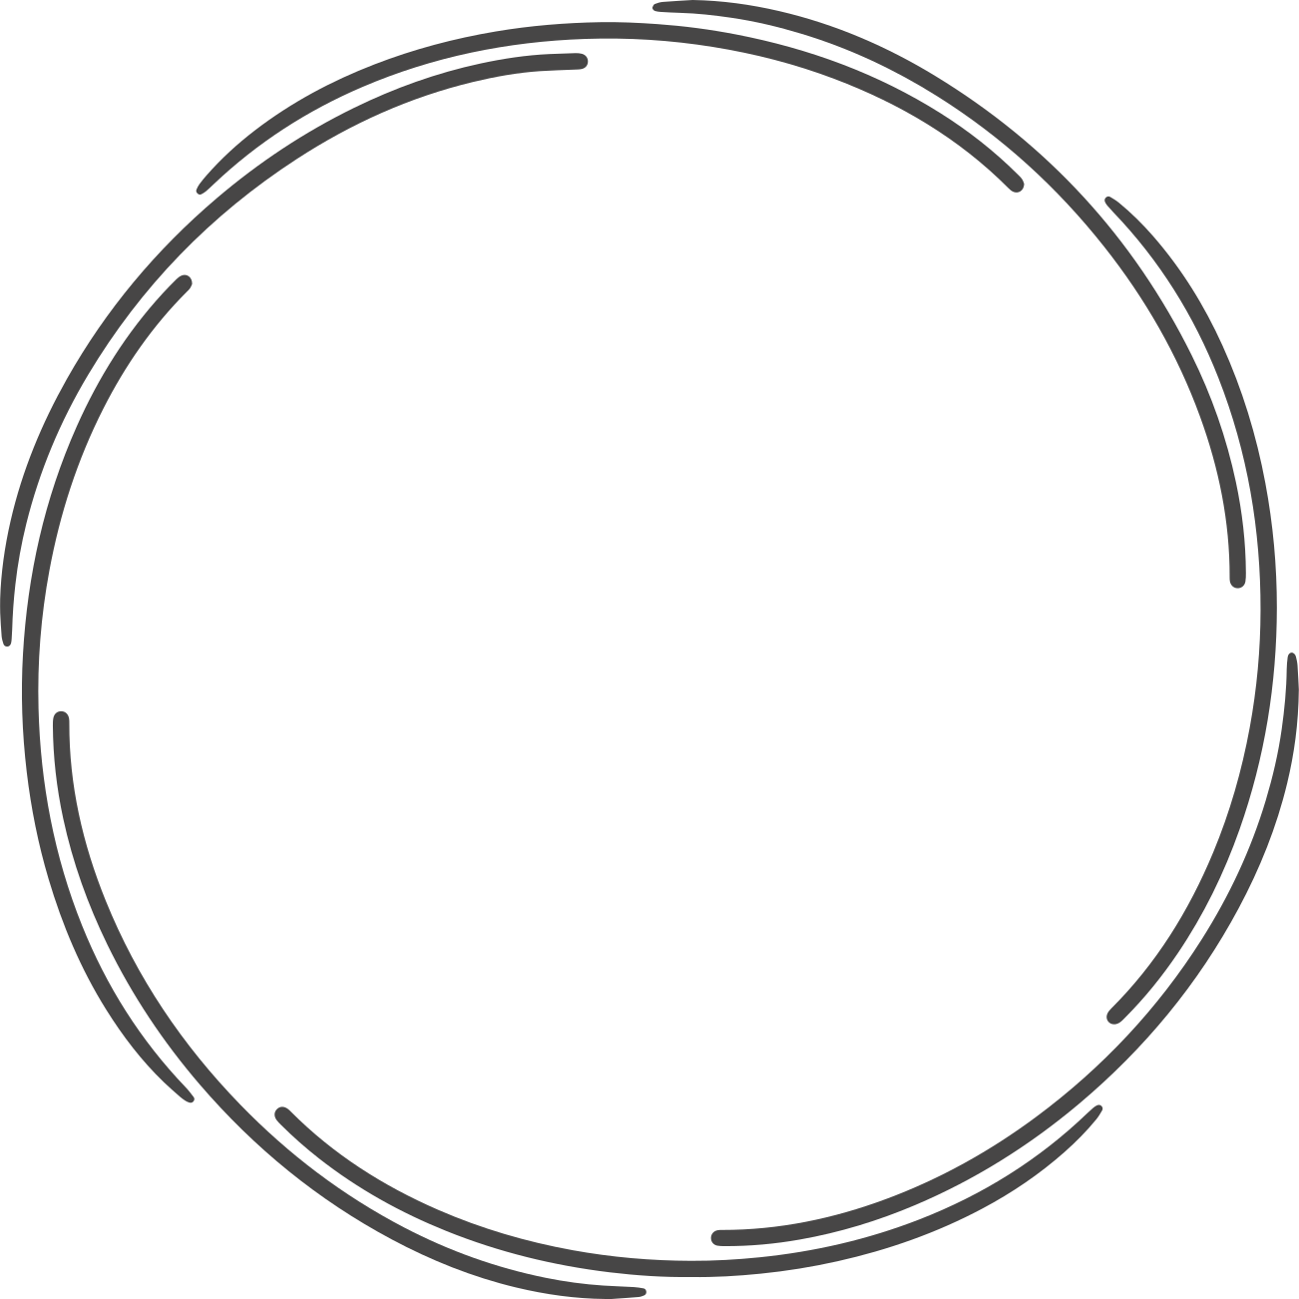
SALES AUTOMATION SYSTEM
22Z329 - Jansirani A S
22Z346 - Neha
22Z349 - Srujana N
22Z366 - Srinithi R B
22Z370 - Thirisha P

Slide 2
INTRODUCTION
A Sales Automation System is a software system used to manage and automate sales activities in an organization. It helps businesses store customer information, track sales, and manage orders easily.
In the past, many sales activities were done manually, such as maintaining customer records and preparing reports. This process was slow and could lead to mistakes. A Sales Automation System solves this problem by storing all sales data digitally and automating many tasks.

Slide 3
NEED FOR SALES AUTOMATION SYSTEM
Helps businesses manage large amounts of sales data easily.
Reduces manual work involved in maintaining customer records and sales information.
Improves accuracy of data and reduces human errors.
Allows sales teams to track customer interactions and follow-ups.
Helps in managing customer orders and sales transactions efficiently.

Slide 4
FEATURES OF SALES AUTOMATION SYSTEM
Customer Management: Stores customer details and purchase history.
Sales Tracking: Keeps records of sales activities and transactions.
Lead Management: Helps track potential customers and follow up with them.
Order Management: Records customer orders and monitors their status.

Slide 5
OVERVIEW OF THREE-TIER ARCHITECTURE
Three-Tier Architecture is a software design model where an application is divided into three separate layers (tiers).
Purpose:
Improves scalability, security, and maintainability
Each layer performs a specific function
Changes in one layer do not affect the others
In a Sales Automation System:
Helps manage customer data, sales tracking, and reporting
Ensures smooth communication between users, business logic, and databases

Slide 6
STRUCTURE OF THREE-TIER ARCHITECTURE
A Sales Automation System typically consists of three layers:
Presentation Tier (User Interface Layer)
The front-end where users interact with the system
Displays information and collects user input
Application Tier (Business Logic Layer)
Processes the user requests
Applies business rules and workflows
Data Tier (Database Layer)
Stores and manages application data
Handles data retrieval and storage
Example:
Salesperson enters customer order → Application processes it → Data stored in database.

Slide 7
WHY THREE-TIER ARCHITECTURE IS USED IN SALES AUTOMATION
1. Better Security
Database is not directly accessed by users.
2. Easy Maintenance
Developers can update one layer without affecting others.
3. Scalability
System can handle more users and larger data as sales grow.
4. Improved Performance
Each tier can be optimized separately.
Example in Sales Automation:
Sales teams can track leads, customer information, orders, and sales reports efficiently.

Slide 8
PRESENTATION TIER
The Presentation Tier is the top layer of a Sales Automation System. It is also known as the User Interface (UI) layer because it allows users to interact with the system.
This layer allows users such as sales representatives, managers, and customers to access the system and perform different sales activities. It provides screens, forms, menus, and dashboards through which users can interact with the system.
The main function : It is to collect user input and display system output.

Slide 9
FUNCTIONS OF THE PRESENTATION TIER
User Interface (UI) :
The presentation tier provides the interface such as screens, forms, and menus that allow users to interact with the system.
Input Collection :
It collects input data from users, such as customer details, product orders, and sales information.
Displaying Information :
It displays information to users, including product details, order status, and sales reports.

Slide 10
FUNCTIONS OF THE PRESENTATION TIER
Sending Requests to Application Tier :
The presentation tier sends the user’s request to the application tier for processing.
Displaying Processed Results :
After processing is done in the application tier, the results are returned and shown to the user.
Improving User Experience :
It ensures the system is easy to use by providing a clear and user-friendly interface.

Slide 11
Features of Presentation Tier :
User-friendly interface – Easy to understand and use.
Fast response – Displays information quickly.
Interactive design – Allows users to navigate different pages easily.
Accessibility – Can be accessed through web browsers or mobile devices.
Example Scenario in Sales Automation System :
A sales representative logs into the system.
The presentation tier shows the dashboard.
The user enters customer order details.
The request is sent to the application tier for processing.
The result (order confirmation) is displayed to the user.

Slide 12
APPLICATION TIER
The Application Tier is responsible for implementing the business logic of the sales automation system. It processes user requests from the presentation layer, applies business rules, and communicates with the database layer to retrieve or store information.
It acts as a bridge between the user interface and the database, ensuring that the system functions according to the organization’s sales policies and workflows.

Slide 13
FUNTIONS OF APPLICATION TIER
1. Sales Process Management
Handles the entire sales workflow.
Processes activities such as creating sales orders, updating order status, and tracking transactions.
Ensures correct processing of sales data before storing it in the database.
2. Business Logic Implementation
Implements rules related to pricing, discounts, tax calculations,
and commissions.
Ensures sales operations follow company policies.

Slide 14
FUNTIONS OF APPLICATION TIER
3. Customer Management Processing
Manages customer information and interactions.
Handles operations such as adding new customers, updating profiles, and tracking purchase history.
4. Sales Analytics and Reporting
Processes sales data to generate reports and performance metrics.
Supports decision-making by analyzing:
Sales trends
Product performance
Customer buying patterns

Slide 15
FUNTIONS OF APPLICATION TIER
5. Order Processing and Validation
Validates orders before they are stored in the database.
Checks for:
Product availability
Correct pricing
Customer details
Advantages of Application Tier
Centralized business logic management
Improves security and data validation
Allows easy updates without changing the user interface

Slide 16
DATA TIER
The Data Tier is the foundation of the Sales Automation System.
It stores, organizes, and manages all sales-related data efficiently.
It ensures reliable communication between the application and stored data.
Acts as a central repository for all business information.

Slide 17
FUNCTIONS OF THE DATA TIER
1. Customer Data Storage:
Stores customer details such as name, contact information, and purchase history.
Helps in understanding customer behavior and preferences.
2. Sales Records Management:
Maintains records of all sales transactions and activities.
Supports tracking of daily, monthly, and yearly sales.
3. Order Data Management:
Stores customer orders, order status, and delivery details.
Helps monitor order processing and completion.

Slide 18
FUNCTIONS OF THE DATA TIER
4. Product Information Storage:
Maintains product details like price, stock availability, and specifications.
Ensures accurate product data for sales operations.
5. Data Retrieval for Processing:
Provides required data to the application tier for processing and reporting.
Enables quick access to information when needed.

Slide 19
FUNCTIONS OF THE DATA TIER
6. Data Security and Access Control:
Protects sensitive sales data from unauthorized access.
Ensures only authorized users can view or modify data.
7. Data Integrity and Consistency:
Ensures all data remains accurate, consistent, and up-to-date.
Prevents duplication and errors in the database.
8. Backup and Recovery:
Regularly creates backups of important data.
Restores data in case of system failure or data loss.

Slide 20
FEATURES OF DATA TIER
Centralized data storage and management.
Improves data security and access control.
Ensures data accuracy and consistency.
Supports backup and recovery.
Enables efficient handling of large data.

Slide 21
CONCLUSION
Sales Automation System improves efficiency by automating sales processes.
It reduces manual work and minimizes errors.
Three-tier architecture ensures security, scalability, and performance.
Overall, it helps businesses manage sales effectively and make better decisions.

Slide 22
THANK YOU
22Z329 - Jansirani A S
22Z346 - Neha
22Z349 - Srujana N
22Z366 - Srinithi R B
22Z370 - Thirisha P

